Slide 1



Broadband experiments for 31P and 19F and other considerations for quantitative results PRELIMINARY!!
Peter Gierth 09/12/2025
Senior NMR Specialist, Yusuf Hamied Department of Chemistry
University of Cambridge ptg20@cam.ac.uk

Slide 2
PRELIMINARY DOCUMENT
This is a work in progress – basically so I can give out some details to certain users for test experiments
Some of the descriptions are pretty rough…
There is more text in the notes for each slide!

Slide 3
Problem
Signal intensity in NMR spectra is not generally uniform over whole shift range
Range of frequencies we can excite is inversely proportional to pulse length
Minimum pulse length is limited by hardware/physics
For proton this is ~ non issue
For 31P and 19F this can be severe issue.
Notes:
We normally assume that the integral of a peak/multiplet in an NMR spectrum, is directly proportional to the number of nuclei contributing to that integral. This is generally true, but the constant of proportionality is in general not the same for all peaks in the spectrum!
There are lots of factors that influence the relative integrals, but one of the more problematic ones is that we can’t excite an unlimited range of frequencies in a single experiment. The pulse we apply to excite the spins is associated with a certain magnetic field strength, which is limited by the hardware in various ways; in single pulse experiments the range of frequencies we excite is comparable with the product of the magnetic field generated by the pulse and the magnetogyric ratio of the nucleus under observation.
For nuclei with small chemical shift ranges (in ppm units) uniformly exciting the frequency range of interest may be simple, as is the case for proton. However it turns out for many interesting nuclei the shift range we want to cover is large enough that uniform excitation is not so trivially possible. 19F and 31P are examples that particularly apply here in open access automation – we can’t easily modify experimental parameters on the fly, so it’s useful to have experiments that cover as many use cases as possible. It turns out that we can modify experiments to give much more uniform excitation, but there are always potential compromises.

Slide 4
Why nonuniformity?
In the reference frame of the pulse, magnetization corresponding to a signal at the centre of the spectrum (“on resonance”) is purely rotated by the pulse
“Off resonance” magnetization also experiences a residual static field, proportional to the offset from centre of spectrum. This rotates magnetization about the z-axis during the pulse
Overall, rotation is about an effective field axis which is the vector sum of the pulse and the residual static field.
For large offsets this effective field is close to the z-axis and the pulse doesn’t do anything
For smaller offsets the pulse does not produce perfect rotation into the transverse plane
Notes:
In the NMR experiment we create a transverse component of the net magnetization arising from spins in a particular chemical environment, and this magnetization precesses around the z-axis, inducing a current in the coil situated around the sample, this gives rise to the NMR signal. The precession frequency is the product of the (chemically shielded) local magnetic field at the nucleus and the magnetogyric ratio of the nucleus, and is eg ~400MHz for protons in a 9.4T magnet.
It’s easiest to look at what happens during a pulse, from the point of view of a reference frame rotating at the exact absolute frequency of the centre of the NMR spectrum. In this reference frame, any transverse magnetization for a given environment created by a pulse rotates about the Z axiz not at the real NMR frequency, but at the difference between the exact NMR frequency for that environment and the centre frequency of the spectrum. We call this the offset.
If a peak is at the exact centre of the spectrum, the offset is zero, and the associated magnetization doesn’t rotate about the z-axis in this frame of reference. The pulse causes the magnetization to rotate about e.g the x-axis in this frame, and since there is no rotation about the z-axis the rotation is straightforward. We calibrate the pulse so that we know how long it has to be left on for to rotate the magnetization through a certain angle, eg 90 degrees gives the maximum transvere component and (all else being equal) the most signal.
Now considee the magnetization responsible for a peak not at the centre of the spectrum. In our rotating reference frame this still rotates about the z-axis; for example if a peak is 1000Hz away from the centre of the spectrum the associated magnetization rotates at 1000Hz in this reference frame. If the rate of this rotation is not very small compared to the rate of rotation by the pulse, we get a non-ideal result. We can picture this by thinking of the magnetization rotating about two axes at the same time – the pulse axis, at a fixed rate, and about the z-axis, at a rate which is proportional to the offset. This is represented by a rotation about the (offset dependent) vector sum of the magnetic field of the pulse and the effective residual static magnetic field.

Slide 5
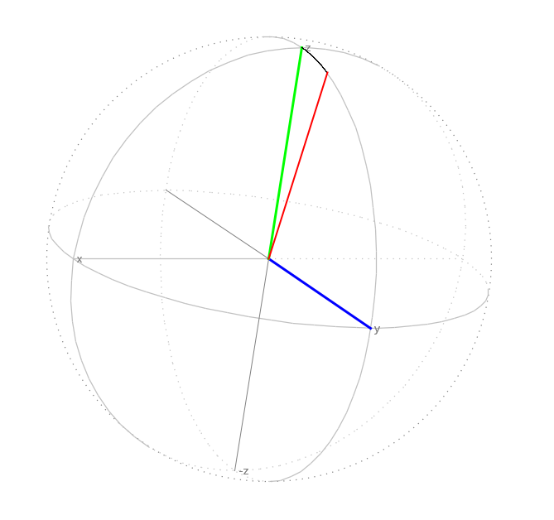
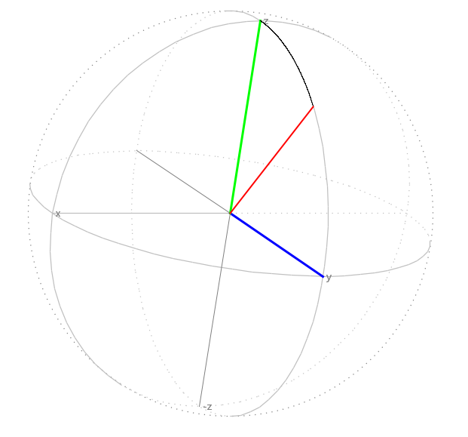
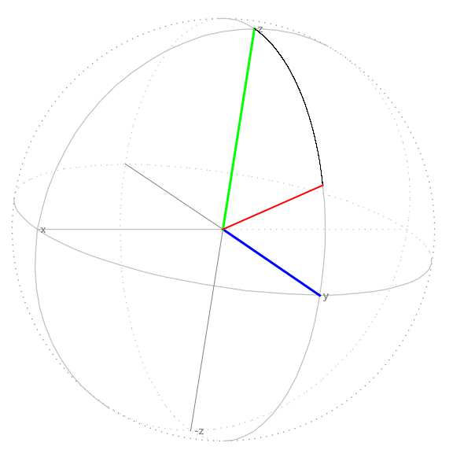
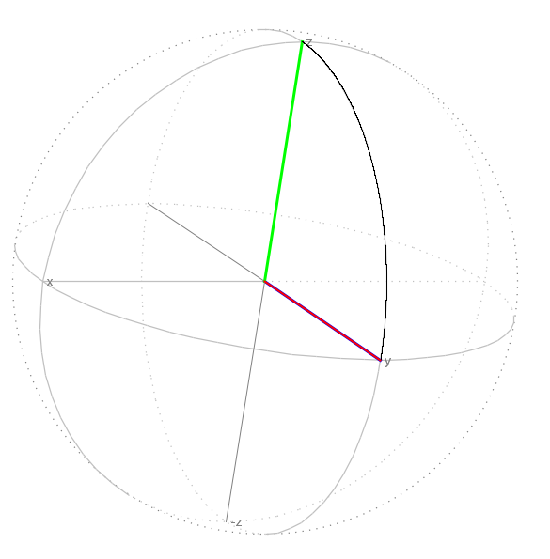
Pulse “on resonance”
Net magnetization starts along Z axis
Rotates around pulse axis - eg X axis
If pulse is calibrated to be 90 degree rotation, ends up along Y axis
Pulse axis
Notes:
On resonance if we look at snapshots of the position of the net magnetization during the pulse, it stays in eg the yz plane, and if the length is calibrated to give a 90 degree rotation the magnetization ends up exactly along the y axis in this rotating frame.
Typical values of the 90 degree pulse length, for reasonably high frequency nuclei (1H, 19F, 31P) are in the vicinity of 10 microseconds.

Slide 6
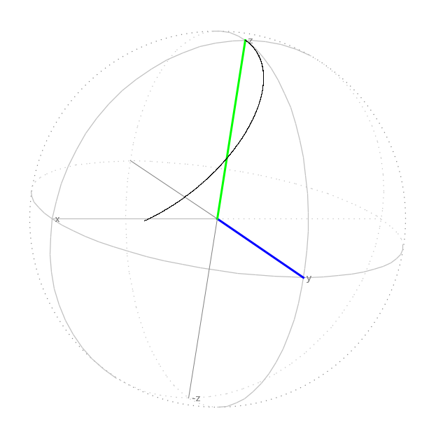
Pulse “off resonance”
Effective rotation axis tilted towards z axis
Magnetization ends up out of the x-y plane – less detected signal
Mengetization not aligned along Y axis
For small offsets, phase in x-y plane ∝ offset – “first order phase”
Notes:
If the magnetization is off resonance, then the axis of rotation is tilted away from the xy plane, and the magnetization does not end up along the y axis if we use a pulse that is calibrated to give 90 degree rotation on resonance. The larger the offset the further away from the y axis the magnetization ends up, and the smaller the component of the magnetization in the transverse plane.
The shift away from the y axis causes a phase error, but for small offsets this error is proportional to the offset - we call this a “first order phase error”, as opposed to the frequency-independent “zero order phase error”. For a given experiment the zero order phase is reproducible (at least over short timescales) but usually requires some adjustment for a given dataset. The first order phase error depends on experimental parameters and in some cases can be eliminated.
For small offsets, much smaller than the inverse of the pulse length, the first order phase approximation is reasonable, and the magnitude of the transverse component of the magnetization is close to the theoretical maximum. As the offset increases however, the magnitude of the transverse magnetization gets smaller and devations from the first order phase approximation occur.

Slide 7
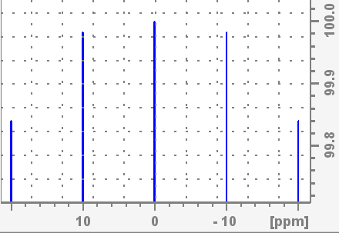
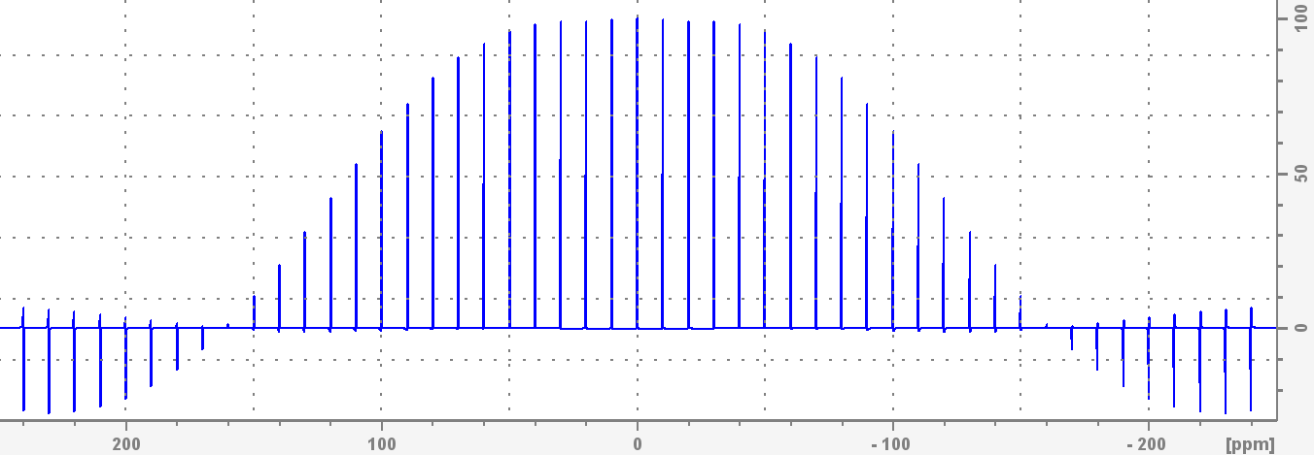
“Excitation profile” of a pulse – 1H case
Glenfairn: 500MHz. 90degree pulse length 12us
Simulated: amplitude of signal after 90 degree pulse as a function of frequency, phase corrected
40ppm
Notes:
The amount of transverse magnetization generated by the pulse, and thus the amount of signal we detect, depends in general on the distance of a peak from the centre of the spectrum and the length (and flip angle) of the pulse we use. Here we have simulated a spectrum with uniformly spaced proton signals over +/- 240ppm, properly phase corrected, on a 500MHz spectrometer. The frequency range we need to cover for protons is not large for diamagnetic molecules - the inset zoom over +/- 20ppm shows the amplitude in this range is better than 99.8% of the amplitude at the centre.
As we get further from the centre the amplitude decreases, until we reach a point where it is zero – at this point the effective magnetic field during the pulse is close to the z-axis and the magnetization gets back to the +z axis at the end of the pulse.
We can say that the zero crossings are at close to +/- 1/(90 degree pulse), so with 12us 90 degree pulse +/- 83kHz. On a 500MHz spectrometer this is +/- 166pm for proton.
The region where we get >99% perfect excitation is about +/- 1/(4*90 degree pulse) , and >99.9% is about +/- 1/(8*90 degree pulse).

Slide 8
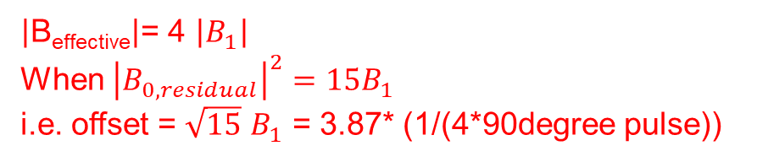
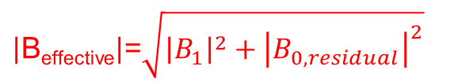
Null points in excitation profile
The rate at which the magnetization rotates during the pulse, depends on the magnitude of the effective field which is the vector sum of the pulse and the offset, which are orthogonal to each other
If the magnitude of this effective field is 4x the pulse field for some offset, if the pulse length is calibrated to be 90 degree rotation on resonance, then at this offset we rotate through 360 degrees about the effective field and are back to the equilibrium state
$\left|\text{B}\text{effective}\right|$=$\sqrt{{\left|B_{1}\right|}^{2}+{\left|B_{0,residual}\right|}^{2}}$
B_{effective}
B_{0,residual}
$\left|\text{B}\text{effective}\right|$= 4 $\left|B_{1}\right|$
When ${\left|B_{0,residual}\right|}^{2}=15B_{1}$
i.e. offset = $\sqrt{15}$ $B_{1}$ = 3.87* (1/(4*90degree pulse))
B_{1,pulse}

Slide 9
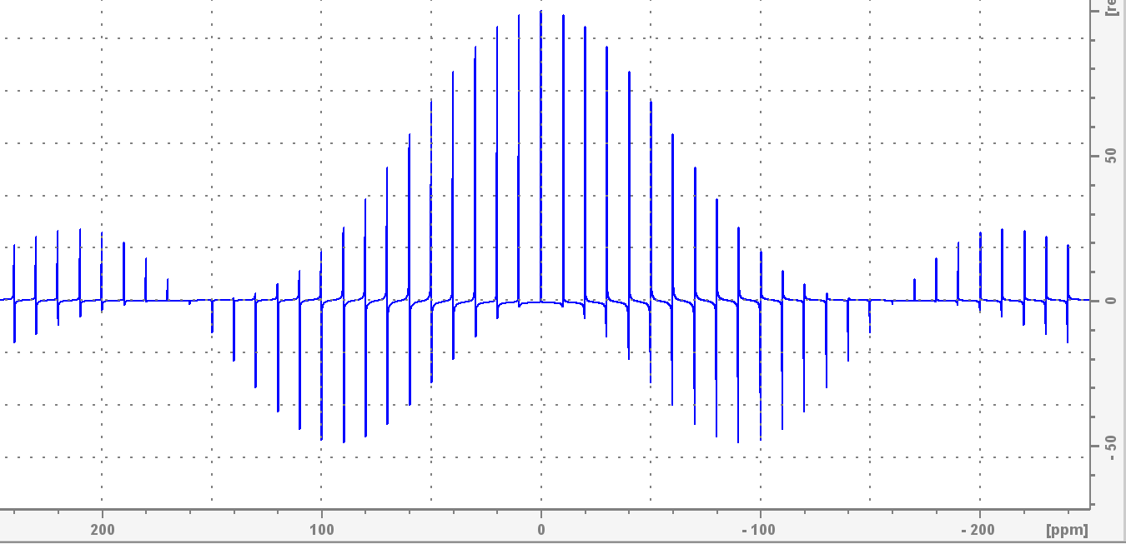
“Excitation profile” of a pulse – 1H case
Before first order phase correction:
Notes:
If we don’t correct the first order phase, then even at very small offsets the apparent intensity is reduced and the signal phase is distorted, because of the rotation about the z-axis during the pulse.
In practice there is also a second contributor to the phase error – we have to have a delay between the end of the pulse, and the start of acquisition, to allow the voltage of the pulse to decay sufficiently that it is negligible compared to the NMR signal, and to allow switching the spectrometer between transmit and receive modes.
In some cases, we can eliminate the requirement for first order phase correction by manipulation of the data, or by careful control of the timing in 2D experiments.
If you can’t phase data easily, a good starting point is to set PHC1 to 0, reprocess with EFP, phase the larges peak in the spectrum using PHC0 only, and then adjust PHC1 to bring everything else in phase.
Ideally for data acquired in automation here, EFP followed by the simultaneous phase and baseline correction command APBK should work.

Slide 10
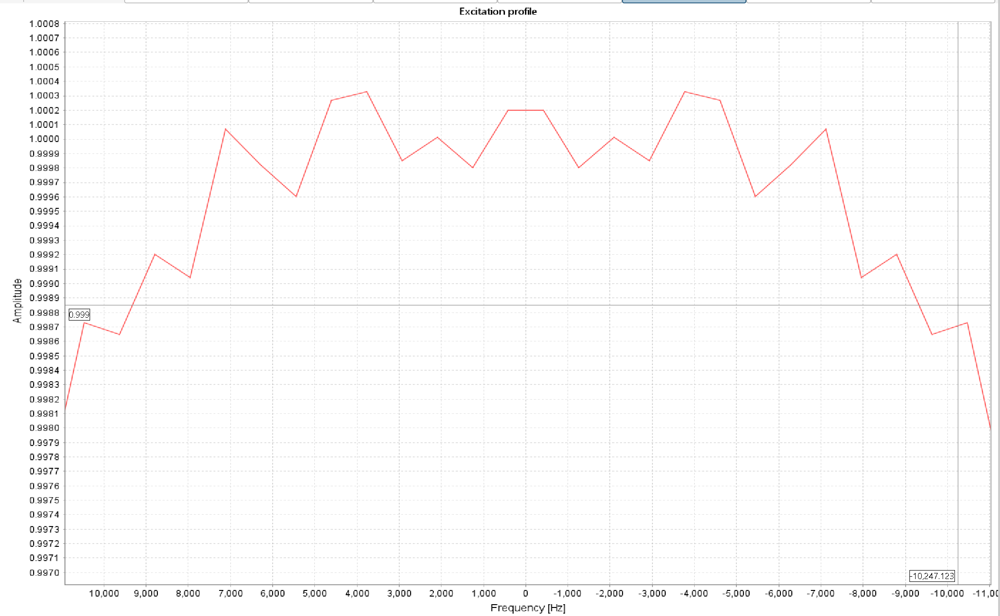
“Excitation profile” of a pulse – 1H case
Expansion shows we get better than 99.9% uniformity over 20ppm range:
99.9%
excitation
20ppm
Notes:
A more fine grained simulation shows that we expect >99.9 % uniform signal excitation over 20ppm in a typical proton spectrum.

Slide 11
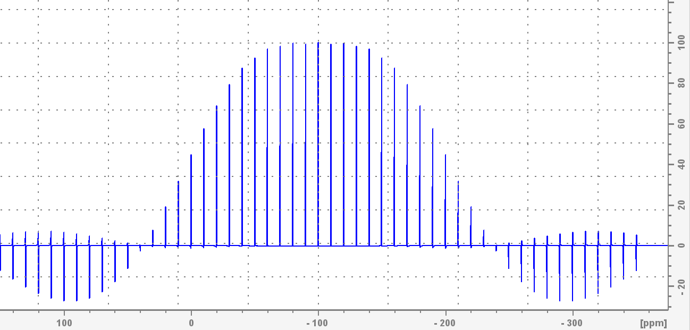
“Excitation profile” of a 90°pulse – 19F case
Glenfairn: 470.67 MHz for 19F. 90°pulse length 15us
Simulated: amplitude of signal after 90 °pulse as a function of frequency
300ppm
Only a small part gives uniform signal
Zero signal at +/- 141.9ppm
Out of phase signals further away
Notes:
For 19F the situation is much worse. For technical reasons the length of 90 degree pulse that can be achieved is not generally as short as that for proton, so the excitation range is smaller in absolute units, and the typical chemical shift range we want to cover is much larger. So a typical 19F spectrum is not meaningfully quantitative.

Slide 12
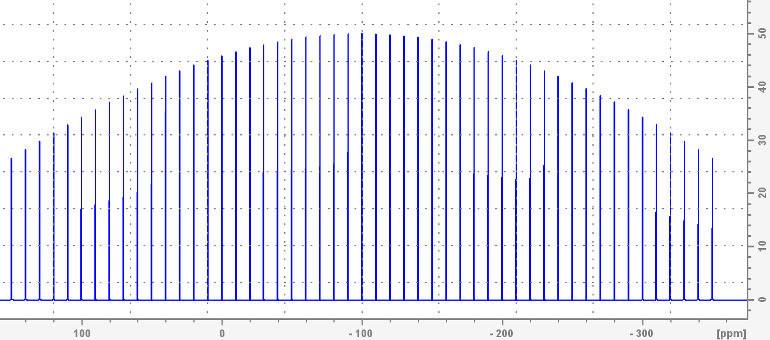
“Excitation profile” of a 30°pulse – 19F case
Glenfairn: 470.67 MHz for 19F. 30 degree pulse length 5us
Smaller flip angle: more uniform but less signal:
300ppm
Still not very uniform,
Only 50% signal in centre
Notes:
Using a smaller flip angle pulse results in better uniformity as a function of frequency, but we haven’t full rotated the magnetization into the transverse plane – the magnitude of the transverse magnetization on resonance is sin(30 degrees) = 0.5. This means worse signal to noise ratio in the centre of the spectrum, but we would at least see signals over a 300ppm range, with at least 1/3 of the theoretical maximum with a 90 degree pulse.
The result is still not really quantitative, though!

Slide 13
Alternative approaches
“Composite pulses”
Concatenation of a number of pulses of certain phases and durations
Originally developed by thinking
Now computer optimized
“Shaped pulses”
Pulse described as a set of time slices of a given amplitude/phase
Computer optimized
“Adiabatic pulses”
Pulses where the frequency is swept over a large range
Can have rather low intensity compared to excitation range
Rather long…
Notes:
Shaped pulses are essentially just the limiting case of composite pulses. A shaped pulse is a list of amplitude and phase values, and each pair of values is applied during a short time slice. Some shapes are constructed from particular mathematical functions but increasingly they are constructed by computer optimization starting from random sets of phase and amplitude values; these can essentially only be understood by simulation.
A specific class of shaped pulses is “adiabatic pulses” – these sweep through a large range of frequencies but rotate magnetization comparatively slowly. They are very useful for inverting magnetization, but their use in excitation is somewhat complicated and requires rather long pulses, during which small amounts of signal may be lost due to relaxation.

Slide 14
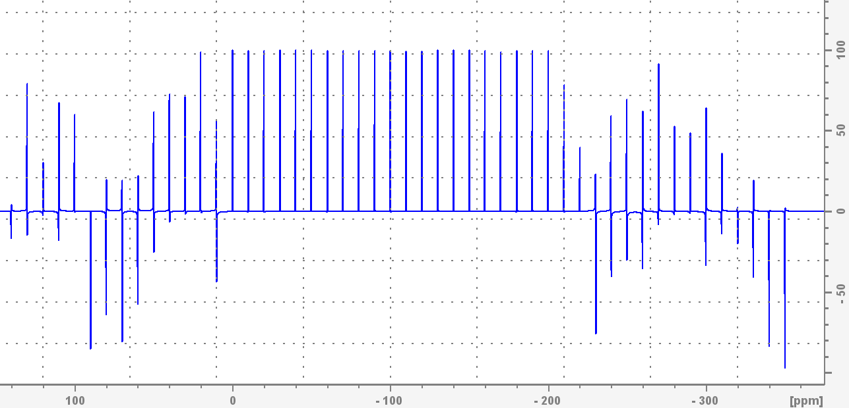
Shaped pulse excitation
BEBOP pulses developed by Luy et al
Best case: bandwidth of about 200ppm for 19F on Glenfairn
Not quite sufficient…
~200ppm
Notes:
The BEBOP family of pulses (Broadband Excitation By Optimised Pulses) are designed to produce more or less exact rotations from the z to eg x axis, for a wide frequency range. This reduces the need for phase correction (although in simple 1D experiments we still need to account for dead time, so this is arguably not so important here)
They are developed using Optimal Control theory, which can produce optimized pulses given specified pulse length, power, and expected result at different frequencies. Although calculated for an extensive set of cases, the most broadband pulses from the originally generated set are still not completely sufficient here.
In principle the theory could be used to create pulses capable of exciting higher frequency ranges, the application is not trivial and we also end up requiring longer pulses.

Slide 15
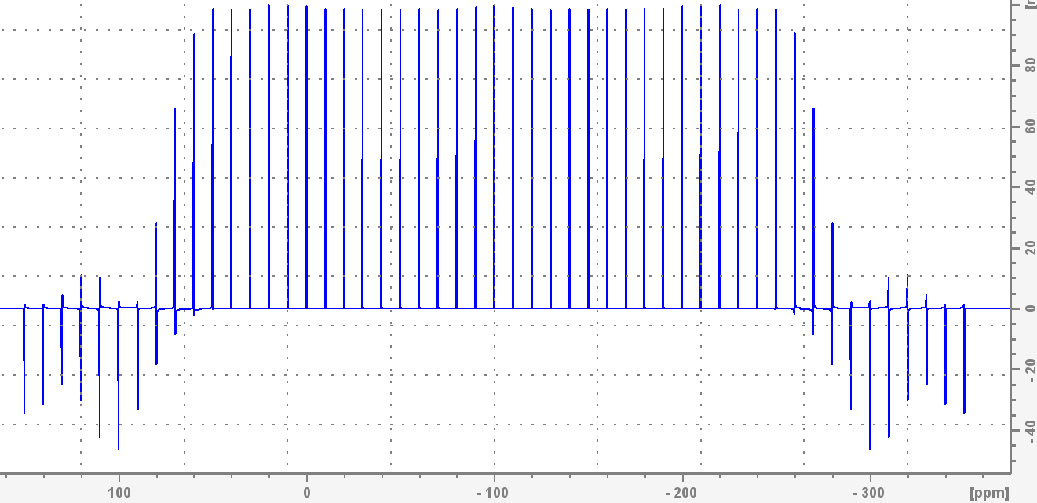
Shaped pulse excitation
OPERA pulses developed by Coote et al
Variety of flip angles – 45 degrees is good compromise
After phase correction:
300ppm
Notes:
A neat trick that allows rather broadband excitation is to recognize that the phase of the magnetization after the pulse, does not have to be uniform, it can have a linear frequency dependence (“first order phase”). Since we already in general have to correct for first order phase errors this is more or less simple.
We need a very large PHC1 correction in principle, but this can be eliminated by special acquisition procedures (as set up on spectrometers here) or we can approximate the required value to make manual or automated correction easy.
With the setup we have implemented here simultaneous baseline and phase correction with APBK should work well.
These OPERA pulses (Optimizing Phase of Excitation Removes Artifacts), have been created for only 4 cases – effective flip angles of 90, 45, 30 and 20 degrees. The length of the pulses was constrained to be very short, to avoid possibly issues with distortion of multiplets due to e.g. coupling between fluorines, and they produce fairly uniform excitation so are suitable for quantitative applications.
The smaller the effective flip angle the wider the excitation range, and in order to cover the required 19F frequency range we have used the 45 degree version.

Slide 16
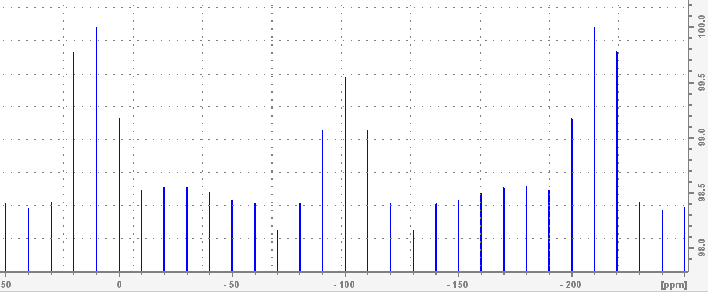
How perfect?
With OPERA-45, simulated maximum error over range corresponding to 300ppm on Glenfairn is >2%:
Notes:
There is still a small imperfection in the uniformity, but there seems to be no scheme that does covers the required frequency range without requiring extremely long pulses (which might lead to intensity distortions due to evolution of couplings or due to T2 relaxation).
If you want the absolute best possible qNMR result this is something that should be handled manually, either on a trained user system or by the service. Then we can optimize for the range of frequencies actually present in your sample.

Slide 17
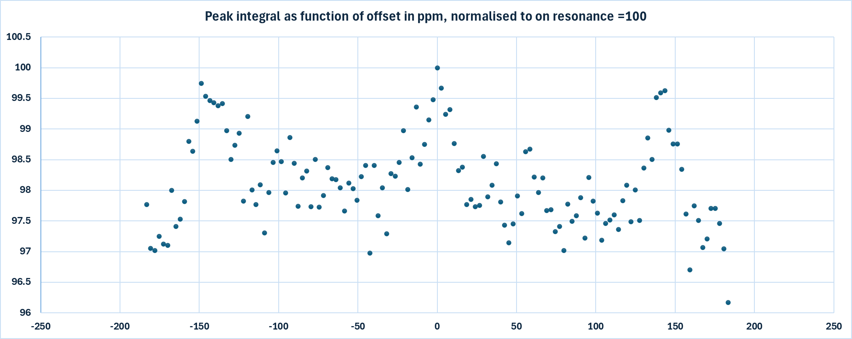
How perfect? Experimental validation
Experimentally the performance is slightly worse, but the range is <3% over 370ppm on Lagavulin
Notes:
There is still a small imperfection in the uniformity, but there seems to be no scheme that does much better without requiring extremely long pulses (which might lead to intensity distortions due to evolution of couplings or due to T2 relaxation).
If you want the absolute best possible qNMR result this is something that should be handled manually, either on a trained user system or by the service. Then we can optimize for the range of frequencies actually present in your sample.
The random error in the integrals is not trivial here, partly because these are single scan measurements, but the shape of the intensity distribution is still visible.

Slide 18
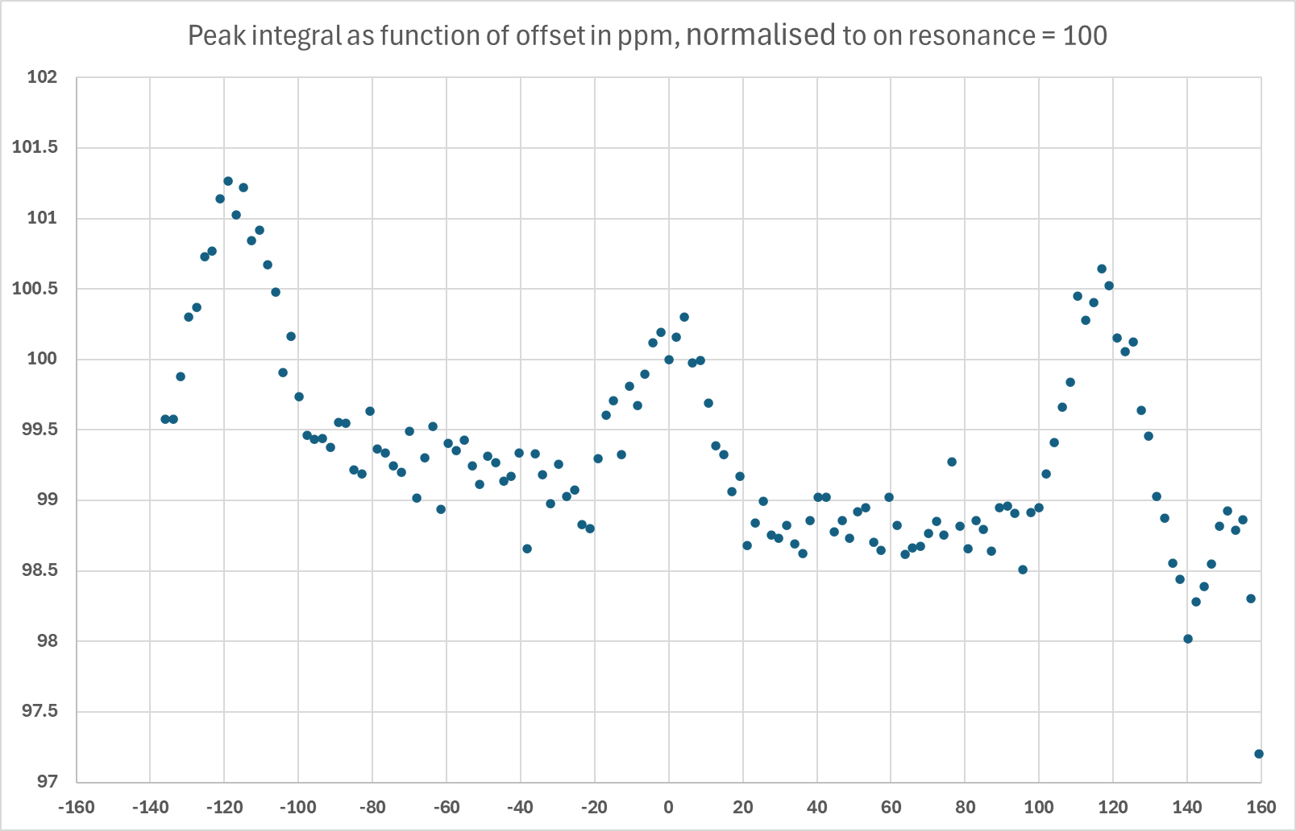
How perfect? Experimental validation
On Glenfairn we cover a slightly narrower range in ppm units
With more optimal acquisition conditions the random error is reduced
Shape of the intensity distribution is the same
Notes:
The apparent random error in integrals is smaller here – this is due to different experimental setup which is in fact more realistic.
The overall drift of the results is probably simply a result of spectrometer changes over time – within one spectrum this downward drift going to higher offsets would not be seen.

Slide 19
Other factors influencing quantification - relaxation
The special pulse just guarantees that excitation of the magnetization is ~perfect
However, we have to worry about relaxation…
After a pulse we have to wait for spins to return to equilibrium
Exponential process; time constant T₁
T₁ is typically of the order 0.1 – 10s for eg 1H, 19F in diamagnetic molecules
T₁ is different even for different protons in the same molecule!
To get quantitative results we need to wait many times T₁
Notes:
One of the somewhat unique features of NMR is the slow timescale on which it operates. In IR and UV-VIS for example systems undergo very rapid return to their equilibrium states by spontaneous emission, but the very small energy level separations mean this is not the case in NMR.
The return to equilibrium in NMR is mediated by fluctuating local magnetic fields, which arise from various interactions:
Dipole-dipole couplings between pairs of nuclei vary with the orientation of the internuclear vector
The anisotropic part of the chemical shift varies with molecular orientation
The quadrupolar interaction between spin >1/2 nuclei and electric field gradients around the nucleus varies with orientation
Paramagnetic interaction (eg with dissolved oxygen in the sample, as well as for paramagnetic species) – rapid electron relaxation causes nuclear relaxation
For protons in particular the dipolar mechanism dominates – relaxation rates of isolated protons are slower. Overall the rate of relaxation depends on both the magnitude of the fluctuations of the local magnetic field, and the rate of fluctuation. The fluctuation rate is represented by the correlation time of rotational motion, the average time taken for the molecule to rotate through 1 radian. Longitudinal relaxation is most rapid when the inverse of the correlation time is equal to the NMR frequency.

Slide 20
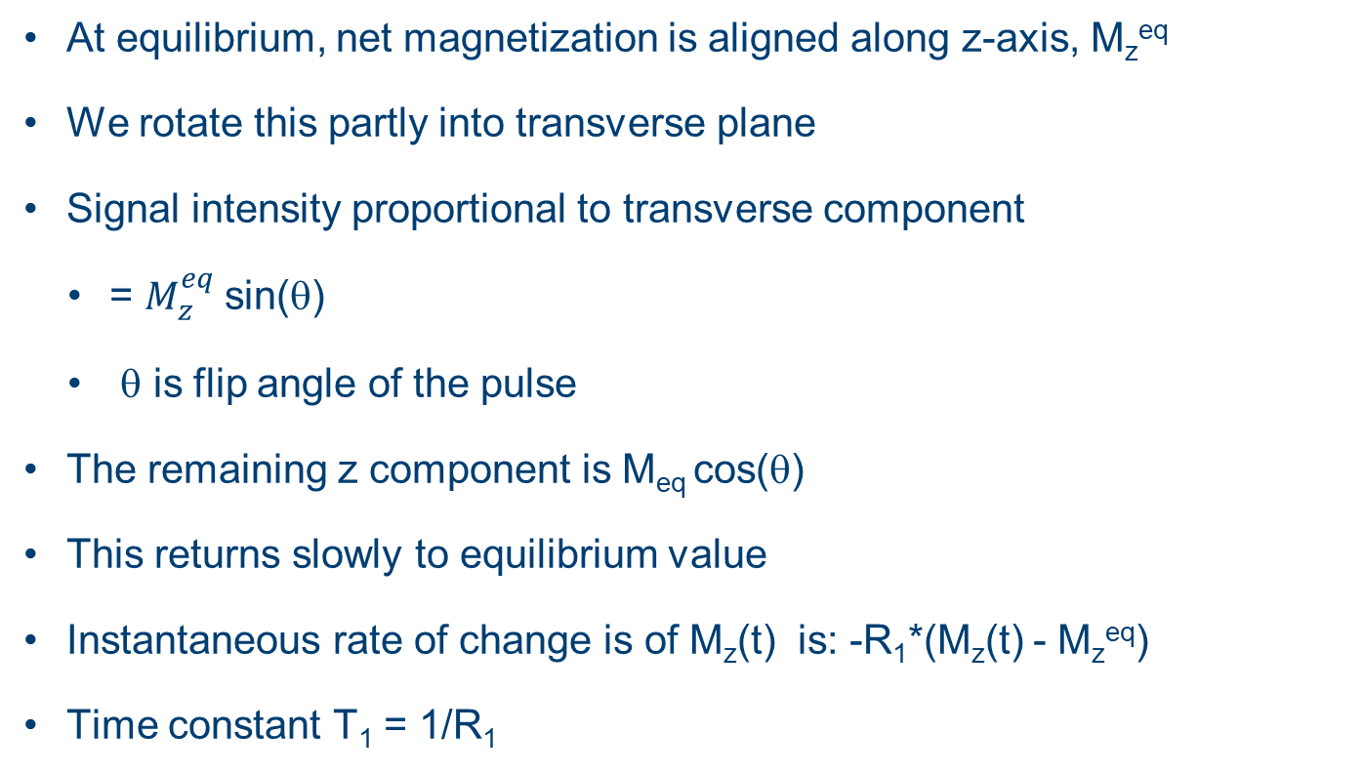
Relaxation
At equilibrium, net magnetization is aligned along z-axis, M_{z}^{eq}
We rotate this partly into transverse plane
Signal intensity proportional to transverse component
= $M_{z}^{eq}$ sin(θ)
θ is flip angle of the pulse
The remaining z component is M_{eq} cos(θ)
This returns slowly to equilibrium value
Instantaneous rate of change is of M_{z}(t) is: -R₁*(M_{z}(t) - M_{z}^{eq})
Time constant T₁ = 1/R₁
Notes:
After applying a pulse to the sample, we can detect the precessing transverse component of the magnetization. The magnitude of this transverse component, and thus the intensity (integral) of the NMR signal, depend on the z component of the magnetization that exists before the pulse, and on how much of the magnetization is rotated into the transverse plane.
During acquisition this transverse component decays, partly due to (transverse, T2) relaxation and partly due to the slightly inhomogeneous magnetic field.
However, it is usually the case that we stop acquiring and acquire the next pulse, before the z component of the magnetization has really completely returned to its equilibrium value. This is largely because the return is asymptotic - as we get close to equilibrium the rate of change of the z magnetization gets very slow.
For maximum sensitivity in a multi-scan experiment, it turns out that the optimal delay between repetitions is about 1.3x T1, but if different signals have different T1 values this makes the experiment very non-quantitative.

Slide 21
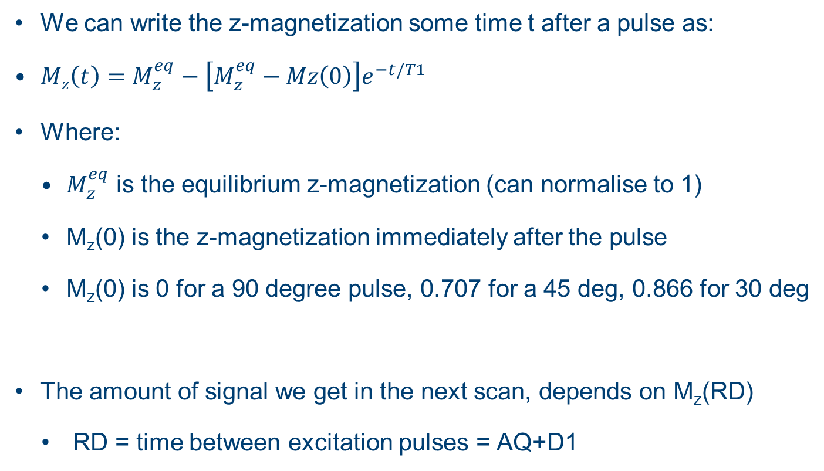
How long between scans?
We can write the z-magnetization some time t after a pulse as:
$Mz\left(t\right)=M_{z}^{eq}−\left[M_{z}^{eq}−Mz\left(0\right)\right]e^{−t/T1}$
Where:
$M_{z}^{eq}$ is the equilibrium z-magnetization (can normalise to 1)
M_{z}(0) is the z-magnetization immediately after the pulse
M_{z}(0) is 0 for a 90 degree pulse, 0.707 for a 45 deg, 0.866 for 30 deg
The amount of signal we get in the next scan, depends on M_{z}(RD)
RD = time between excitation pulses = AQ+D1
Notes:
If we want to quantitatively compare the integral of two signals, either in the same or different spectra, it’s necessary that the fraction of the maximum magnetization that we detect is almost the same for each. Given that the relaxation time constants are in general different, the only way to achieve e.g. <1% error, is to ensure that the more slowly relaxing signal has reached >99% of the equilibrium magnetization before starting the next scan.
NB if we only record a single scan, and we make sure that nothing disturbs the magnetization for a significant time before this, then we can get a quantitative result without an explicit waiting time. This in particular is set up on Arran, Lagavulin amd Laphroaig for the standard proton experiments. Before acquisition probe tuning and shimming take place over at least a minute, and probe tuning uses a very weak signal that does not disturb the magnetization, and shimming uses the deuterium signal of the solvent and does not disturb other nuclei at all.

Slide 22
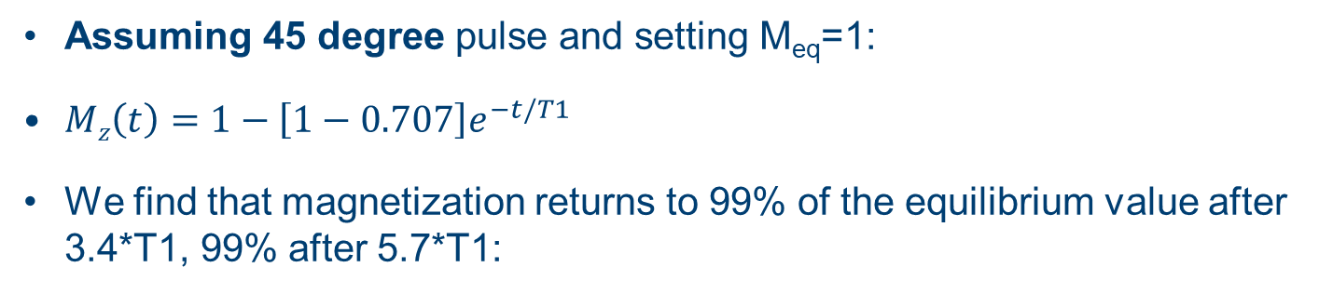
How long between scans?
Assuming 45 degree pulse and setting M_{eq}=1:
$Mz\left(t\right)=1−\left[1−0.707\right]e^{−t/T1}$
We find that magnetization returns to 99% of the equilibrium value after 3.4*T1, 99% after 5.7*T1:
99% after 3.4*T1
99.9% after 5.7*T1
Notes:
Taking our OPERA-45 excitation , we can calculate how much z magnetization exists at various times after the pulse, as a function of the T1 relaxation time constant. We find that for example after 3.4x T1, 99% of the equilibrium magnetization is available.

Slide 23
How long between scans?
We can do similar calculations for 30 or 90 degree pulses
30 degree pulse: 99% at 2.6T₁, 99.9% at 4.9T₁
90 degree pulse: 99% at 4.6T₁, 99.9% at 6.9T₁
With a 45 degree pulse, if we have a total relaxation delay (D1 + AQ) = 3.4x the longest T₁ of any signal, then we have at most 1% error in the intensity of any signal due to incomplete relaxation
But we don’t know what T1 is in general!
So, we use a value that should generally be long enough always
Notes:
The big problem here, is that we don’t in general know what the value of T1 is for any given signal in our spectrum…
We can measure it, but this generally takes a nontrivial amount of time. If we are dealing with weak NMR signals , such that we need to acquire a very large number of scans to get reproducible integrals, it’s worth the effort, but it’s not conveniently automatable.

Slide 24
Compromise setup
Different setups optimized for best S:N and for quantification:
Standard: large number of scans and relatively short D1
Quantitative: small number of scans and long D1
Overnight quantitative with additional T1 measurement
So you can check it is really quantitative…

Slide 25
Other considerations: nOe effects
Decoupling protons disturbs them from equilibrium
Therefore, nOe effects can be generated
But, we want decoupling for best S:N, ideally
Solution: decoupling only during acquisition time
“inverse gated decoupling”
With long relaxation delay, any nOe created relaxes away

Slide 26
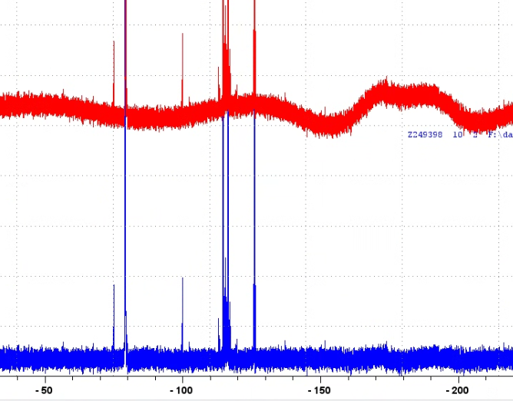
Other considerations: processing
Phase and baseline correction critical
Including around peaks
For 19F, APBK in topspin should do a good job (also suppressing background signal.
New experiments are set up to minimise required first order phase correction
Phase corrected
Probe background signal
After APBK

Slide 27
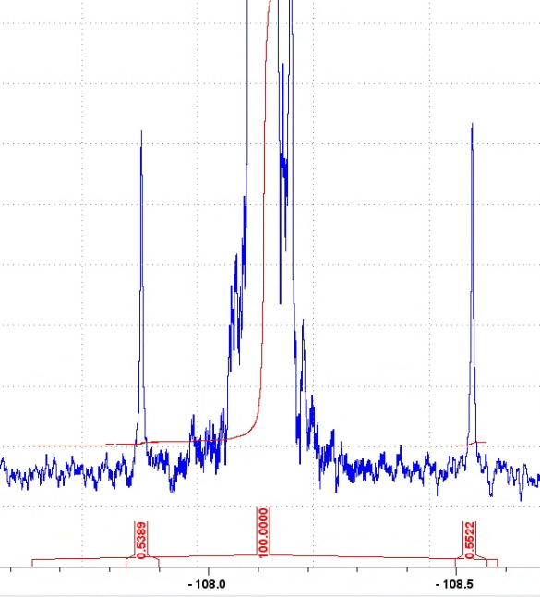
Other considerations: integration
Carbon satellites (offset in 19F spectra due to isotope shift)
0.55% of main peak, each
Either always exclude or always include!

Slide 28
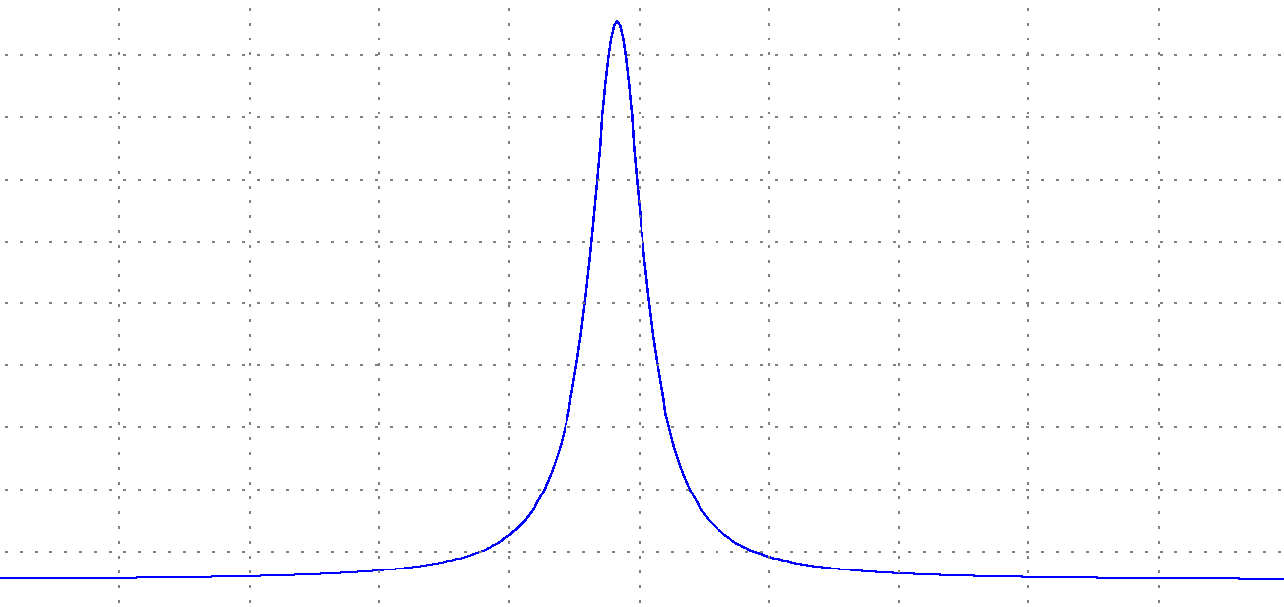


Other considerations: integration
Need to integrate the same fraction of each signal….
NMR signal ideally Lorentzian function$L\left(v\right)=\frac{λ}{π(v^{2}+λ^{2})}$
$$2λ=Full width at half maximum$$

Slide 29


Other considerations: integration
Integral tends to 1, but…
Integral from +v to –v: $I=\frac{2}{π}\tan^{−1}{(\frac{2v}{λ})}$
Integrate +/- 32x linewidth to guarantee 99% of signal
$$2λ=FWHM$$

Slide 30
Other considerations: S:N ratio
Integrals are noisy – in general the integral of a region containing only noise is nonzero
Integral to noise ratio is lower than S:N ratio for large integral range
For +/- 32x linewidth, Integral:noise = S:N*0.61
So for 99% reproducibility of the integral, need S:N for a given peak, of >160:1

Slide 31
Quantitative proton
Single scan quantitative proton run first – no relaxation issues
90 degree pulse for maximum signal

Slide 32
Experiments availaible:
19F QUANT +1H
Daytime, 1 scan proton and 4 scan 19F
QUANT 19F Overnight
16 scan proton with 30s D1
128 scan 19F with 30s D1
19F T1
plus existing 19F and 31P experiments modified to use new parameters

